Slide 1
All about kids club
By evie aged 9

Slide 2
What kids club is ;-0
Kids club is a fun place for kids to play after school when your parents are at work or have things to do, it helps your children build confidence at being creative and doing fun stuff and always doing activities. Like drawing pictures' like this one molly Alan did.

Slide 3
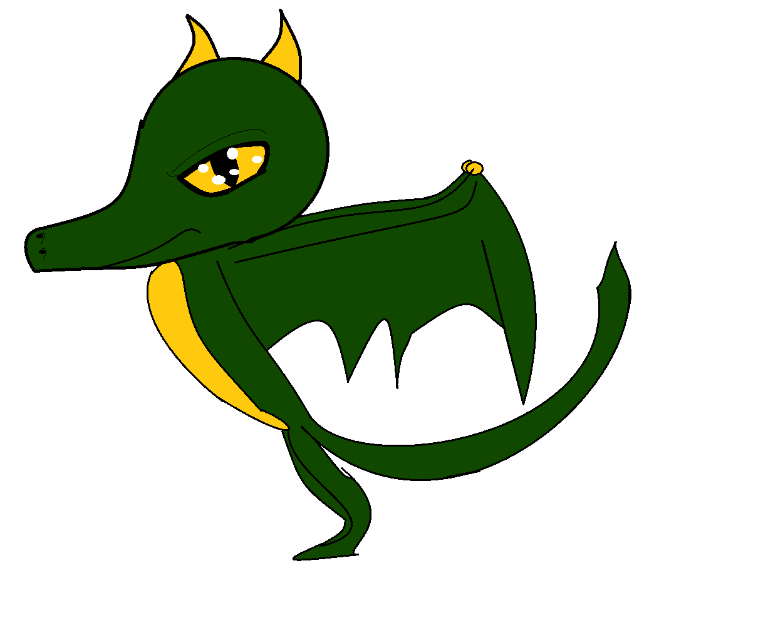
Who works at kids ciub
Kelly ,Tina ,Emma M Emma S, Triner
Stacy , Tarrasa, Beth , Leonie ,Nike ,.All these people work here there are more people that work here are just some examples

Slide 4
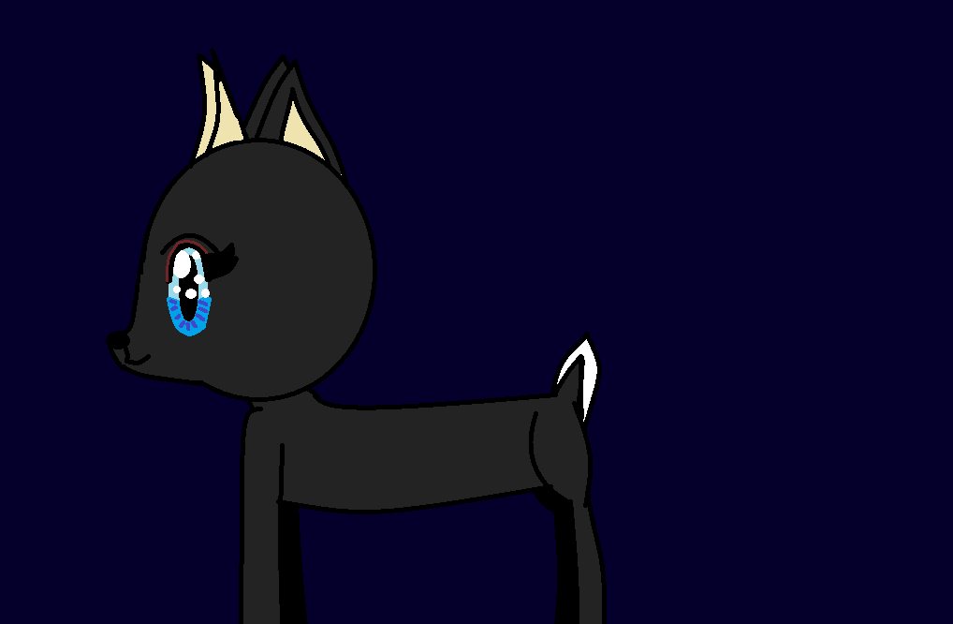
Where we play
We play out side on ruder tarmac with lots of equipment to play with , and a grass area with a dig tunnel at the end of the grass And a growing area to lean in and to smell all the flowers .

Slide 5
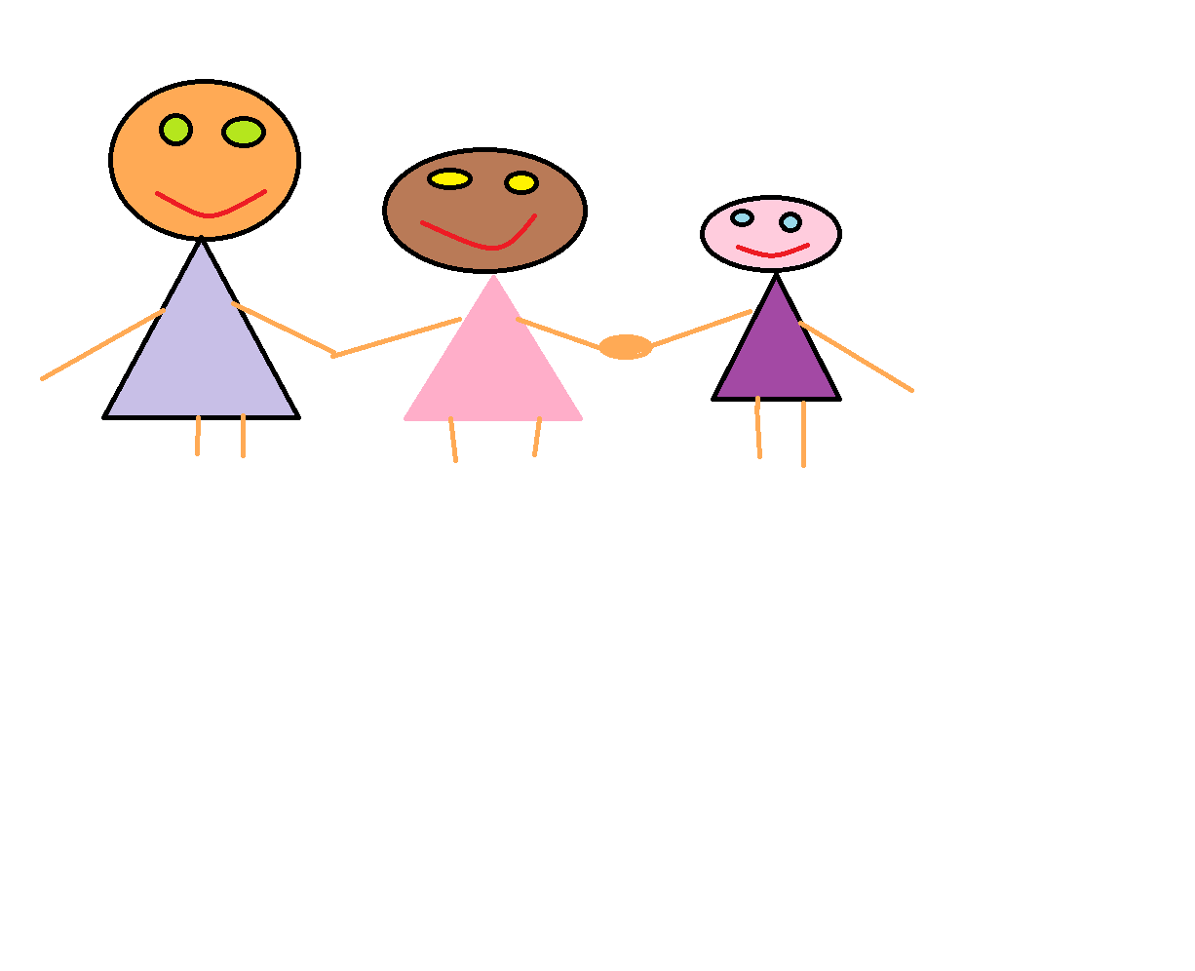
This is kids club
This is Kids club is where we all play and have fun to gather as a team as friends , all together . Kids club is a special place for everyone . we are family.

Slide 6
Thanks for watching
Thank you for watching my power point about kids club☺☺☺☺☺☺;-0

